Slide 1
DJANGO POLL APPLICATION
Ahmed Fathy Sweed
22101981

Slide 2
INTRODUCTION
Django is a high-level Python web framework that allows the development of secure and maintainable websites.
The purpose of my training was to learn Django from scratch and gain practical skills in building web applications.
As part of this training, I developed a Polls Application that allows users to create questions, provide multiple choices, and vote on them.

Slide 3
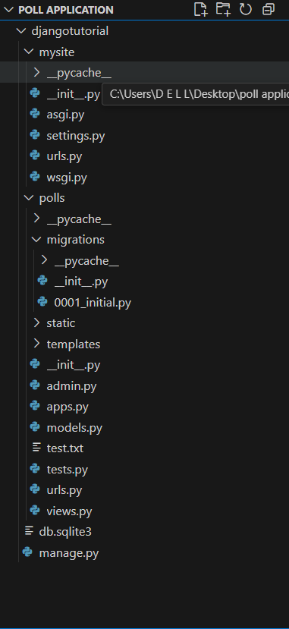
Project Setup
Created a Django project which is called mysite and a polls application inside it.
Configured the database and applied migrations to create tables automatically.
Created a superuser(admin) to manage the application using the Django admin panel.

Slide 4
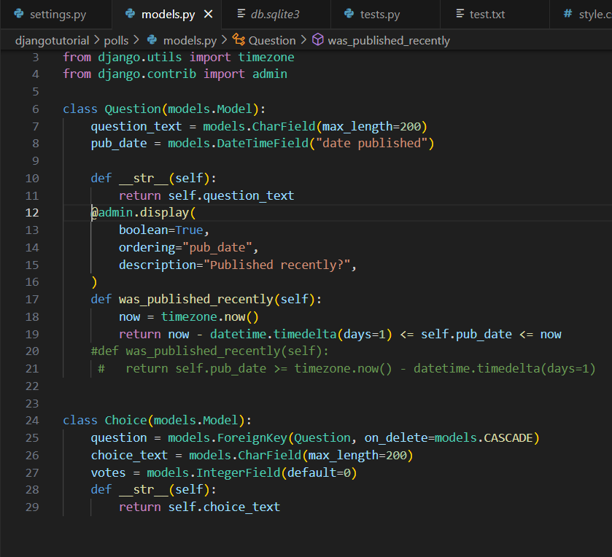
Models
Models act as the tables where the data gets stored and we have two models in this project:
1. Question Model
Stores the question text and publication date.
2. Choice Model
Stores the choice text and number of votes.
Linked to the Question model using a Foreign Key.
Models were migrated into database tables using Django’s migration system.

Slide 5
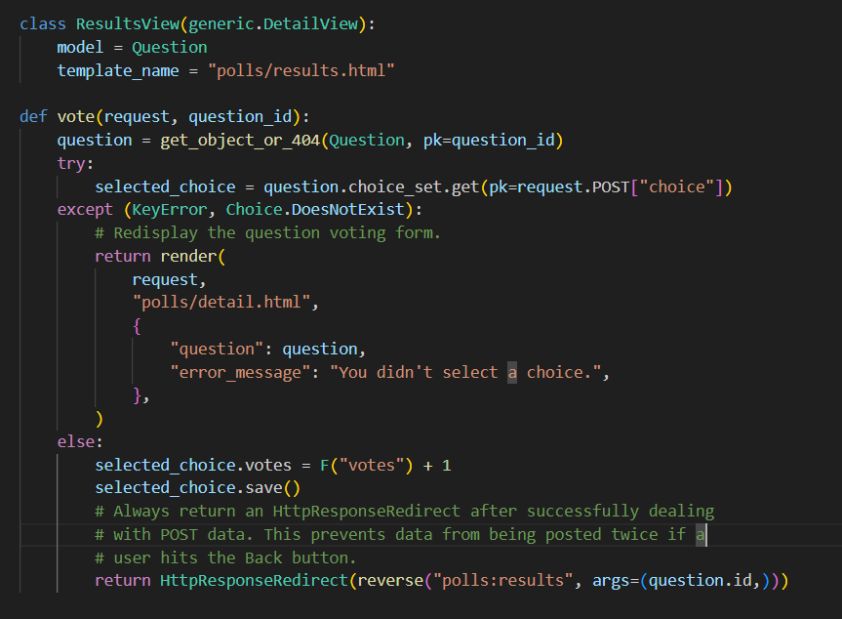
VIEWS
Views are functions or classes in Django that are responsible for handling the logic your web pages and we have four views in our project:
IndexView which displays the latest published questions.
DetailView which shows a specific question and its choices.
ResultsView which displays the results of voting.
Voting function which handles the voting logic and errors.

Slide 6
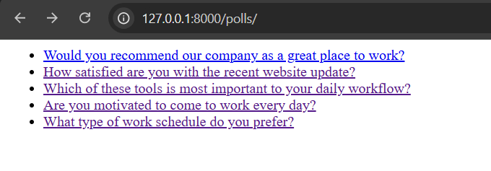
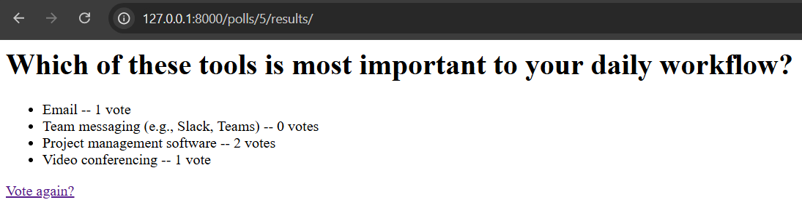
Templates
Templates are HTML files in Django that define how data is presented to the user and we have three templates in our project:
Index.html which displays a list of available questions.
Detail.html which is the voting page where the user selects a choice.
Index.html
3. Results.html which shows poll results with vote count for a specific question.
Results.html

Slide 7
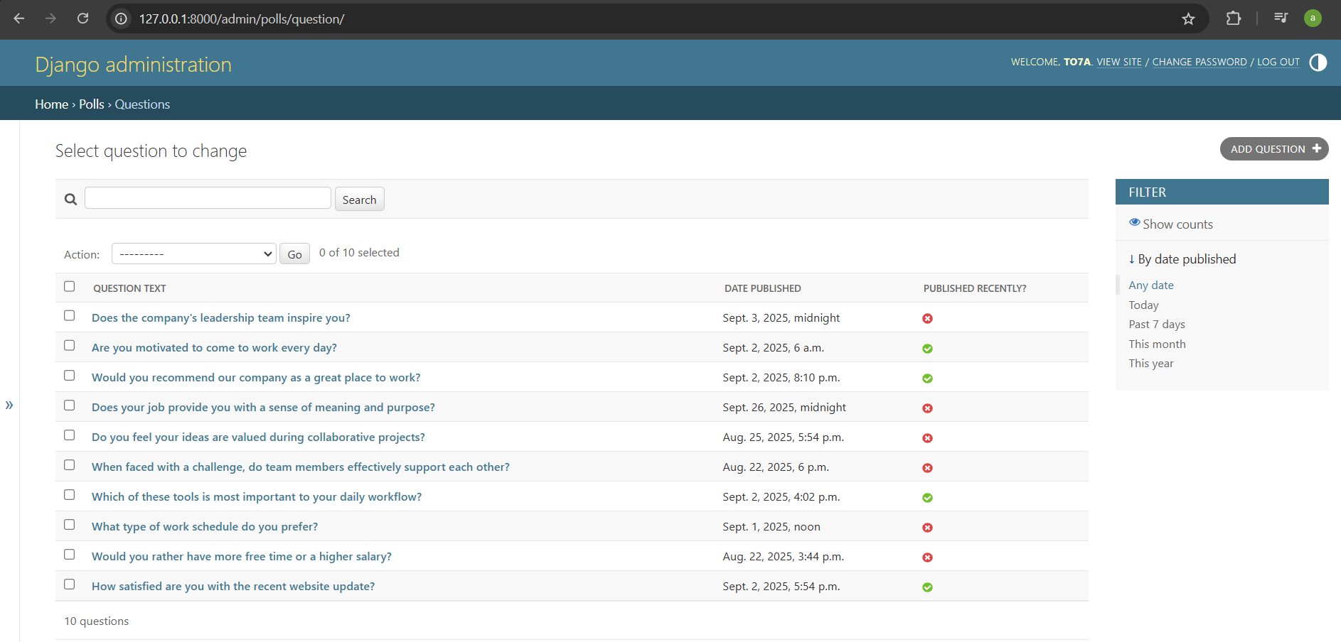
Admin panel
Registered the Question model in the Django admin site.
The admin panel allows adding, editing, and deleting questions and choices.
Provides a convenient interface for managing application data.

Slide 8
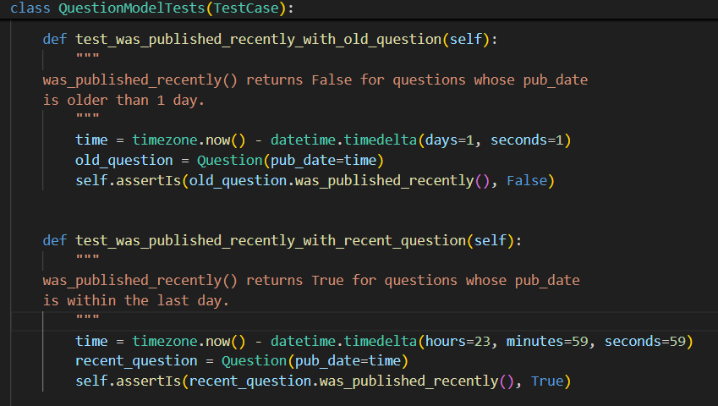
Testing
Wrote unit tests to check application correctness.
Verified that questions with future publication dates are not displayed.
Tested whether polls without questions show an appropriate message.
Highlighted the importance of testing to ensure reliability and correctness.

Slide 9
What I learned
Throughout my training period I have learned a lot about Django and the web generally:
Understood the difference between MVC (Model-View-Controller) and Django’s MVT (Model-View-Template) architecture.
Learned how models, views, templates, and URLs interact to form a complete web application.
Gained hands-on experience with database migrations and the admin interface.
Developed confidence in working with Django’s workflow and structure.

Slide 10
SUMMARY
Successfully built a fully functional Poll Application with Django.
Gained strong understanding of Django fundamentals and web development practices.
Practical project experience helped me apply concepts like models, views, templates, and testing.
This project gave me a solid foundation to build more advanced Django projects in the future.

Slide 11
THANK YOU

